Slide 1
VISUALIZING THE IMPACT OF CLIMATE CHANGE
Data Visualization Final Project
By - Mayur, Gautam, Ikram, Mansi and Sumit

Slide 2
TABLE OF CONTENTS
01
04
02
05
03
06
Introduction
Project Plan
Motivation
Data Visualizations
Dataset
Conclusion

Slide 3

OUR PROJECT
The project covers the cause and effect between climate change and the effects on the globe and specifically on the people of the United States.
CLIMATE CHANGE!

Slide 4
01
Introduction

Slide 5
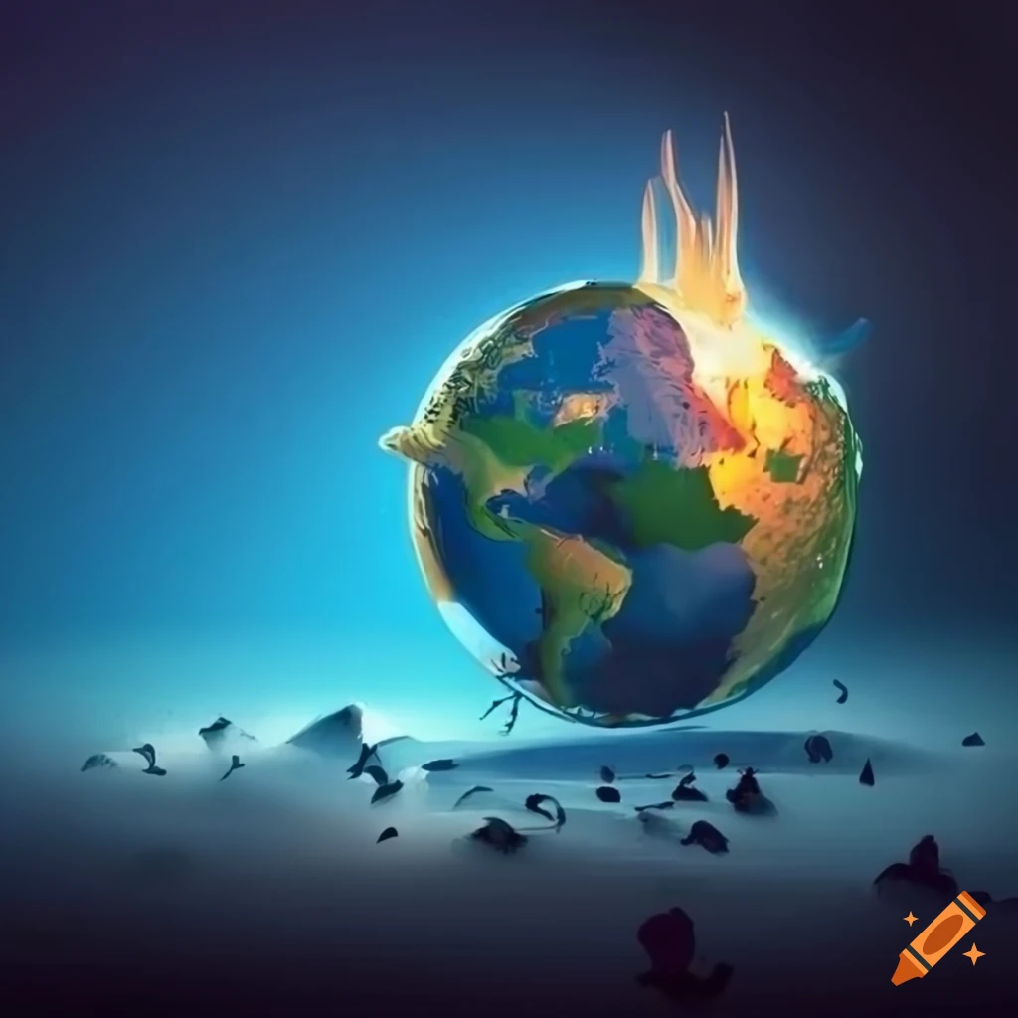
WHAT WE ARE WORKING ON
Project
Climate Change and its effects simplified.
Impact
Helps bridge the gap in scientific and general understanding the effects of climate change.
Analysis
Various climate change factors: temperature, carbon emissions etc to make an interactive dashboard.
Notes:
Climate change represents one of the most pressing challenges of the 21st century, with extensive implications for environmental systems, economic structures, and societal well-being.
Despite the abundance of scientific data, there remains a significant gap between expert understanding and public comprehension of the impact of climate change.
This project aims to bridge this gap by developing an interactive visualization tool that processes multidimensional climate data into accessible, engaging, and informative visual representations.

Slide 6
02
Motivations
Why make this project?

Slide 7
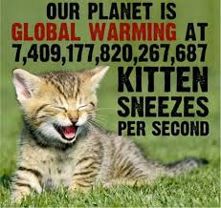
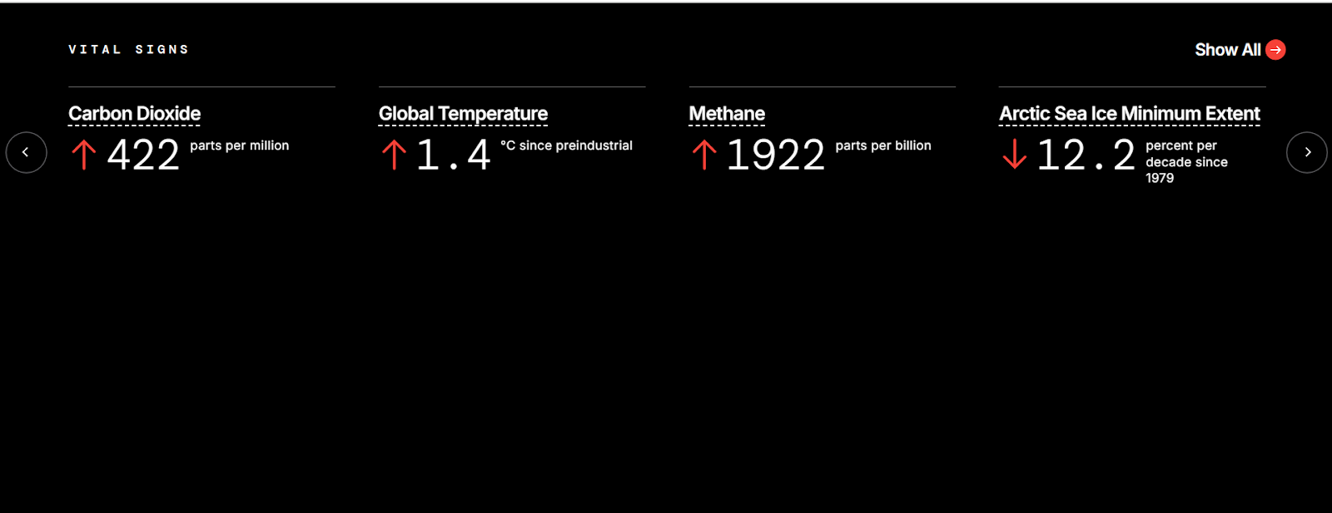
Our main motivation is to give a simplified explanation to the layman about the effects of climate change.
We also aim to make a comprehensive dashboard to help understand complex relations between different attributes.
Make everything transparent and easy to understand.
Fig: NASA’s Climate Change Vital Signs Dashboard
Notes:
Makes no sense right? That’s why we are here to clear such weird and misleading comparisons of climate change and bridge the gap between whats shown and what you should understand.

Slide 8
03
Dataset

Slide 9
DATASET SOURCES
Dataset | Link
Temperature Change | https://climatedata.imf.org/pages/climatechange-data
Forest and Carbon | https://climatedata.imf.org/pages/climatechange-data
GCB Emissions | https://www.kaggle.com/datasets/thedevastator/global-fossil-co2-emissions-by-country-2002-2022
Disaster Frequency | https://climatedata.imf.org/pages/climatechange-data
Melanoma | https://ephtracking.cdc.gov/DataExplorer/
Extreme Precipitation | https://ephtracking.cdc.gov/DataExplorer/
Heat Related illness and mortality rates | https://ephtracking.cdc.gov/DataExplorer/
Exposure to UV | https://ephtracking.cdc.gov/DataExplorer/

Slide 10
109,833
199
8
Total Rows
Total Columns
Total Datasets

Slide 11
04
Project Plan
What did we use in this project?

Slide 12

DATA PROJECT ARCHITECTURE
Question
Data
EDA
Modeling
Feature Engineering
Interpretation
Visualisation

Slide 13
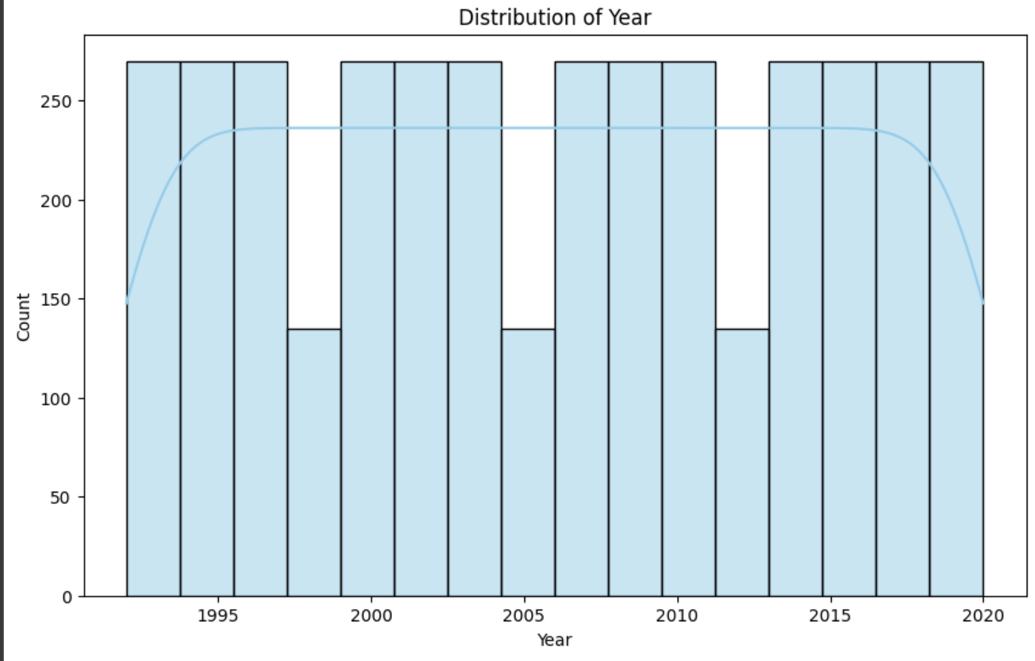
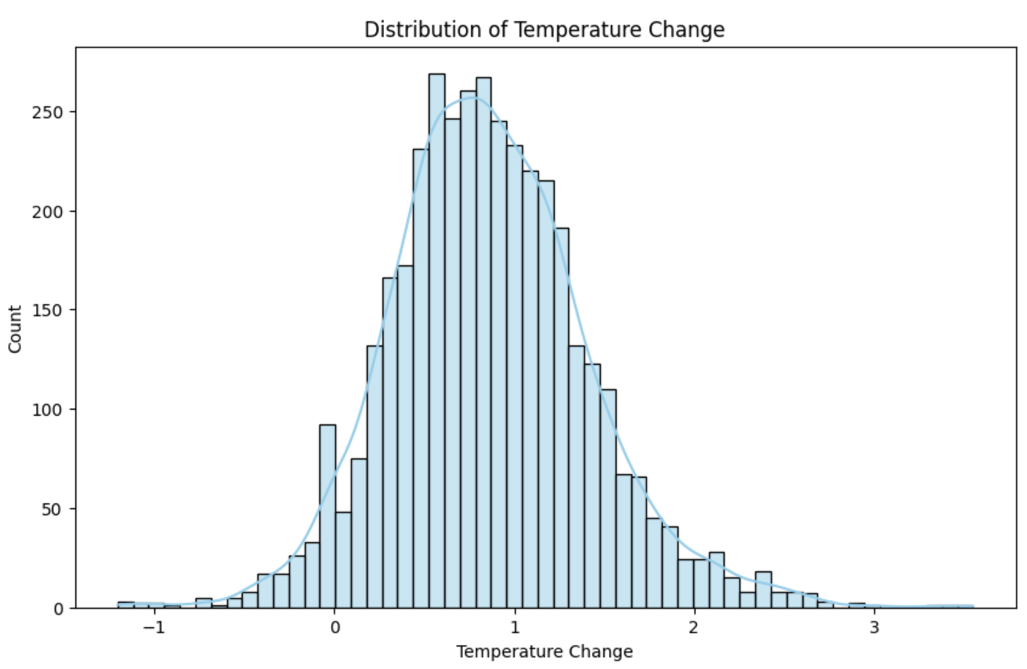
EDA
Distribution of Data

Slide 14
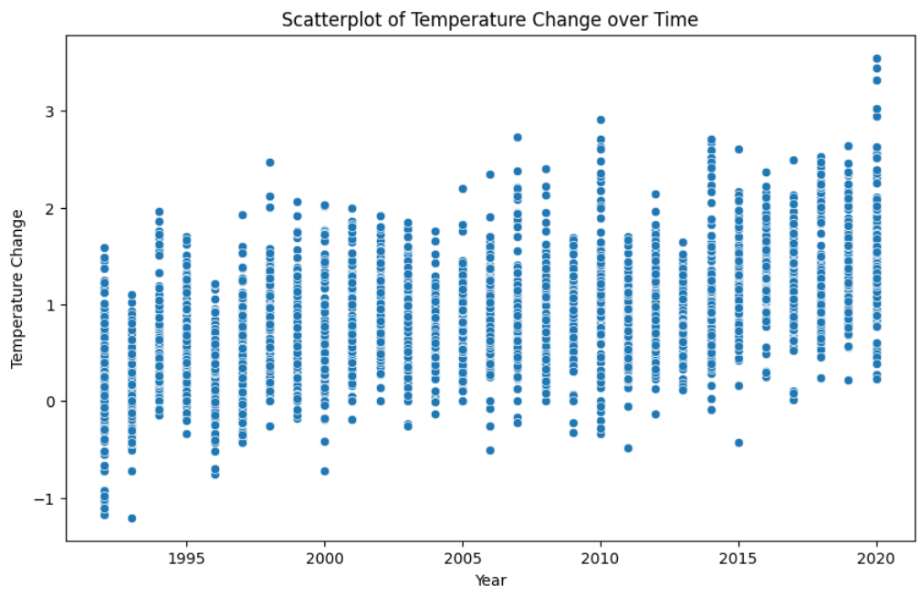
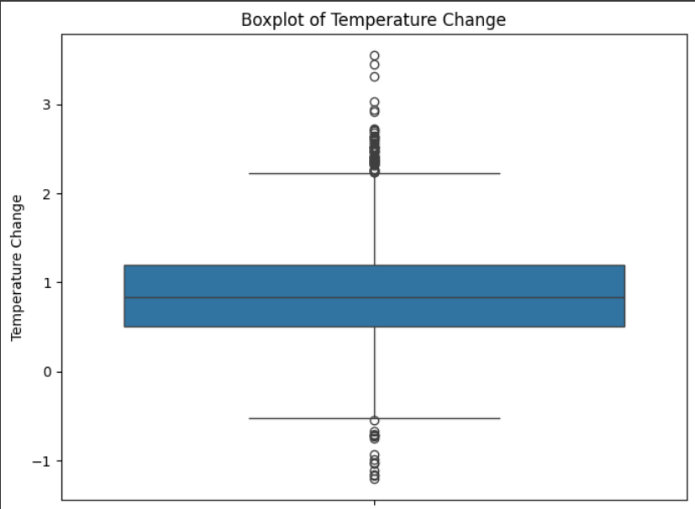
EDA
Outlier detection

Slide 15
05
Data Visualisations

Slide 16
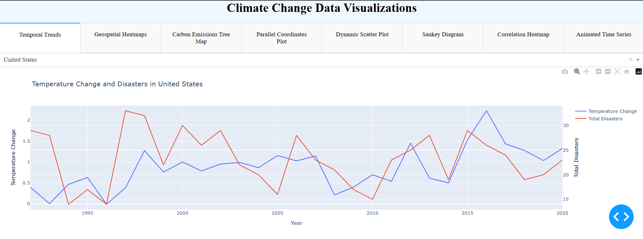

Temperature change and disaster frequency vs years

Slide 17
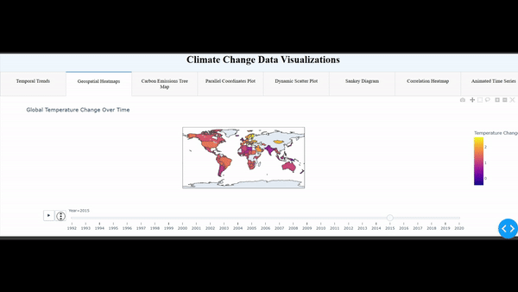
Temperature change vs years

Slide 18
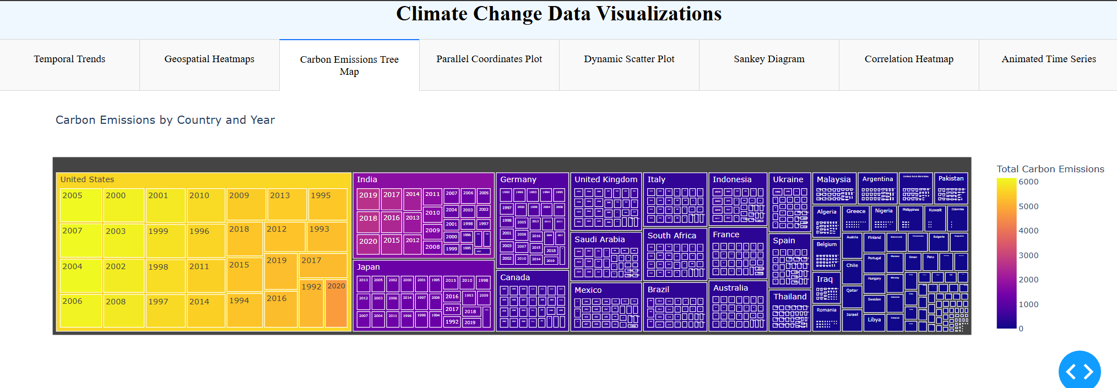
Country-wise Total Carbon Emissions across the years (1992-2020)

Slide 19
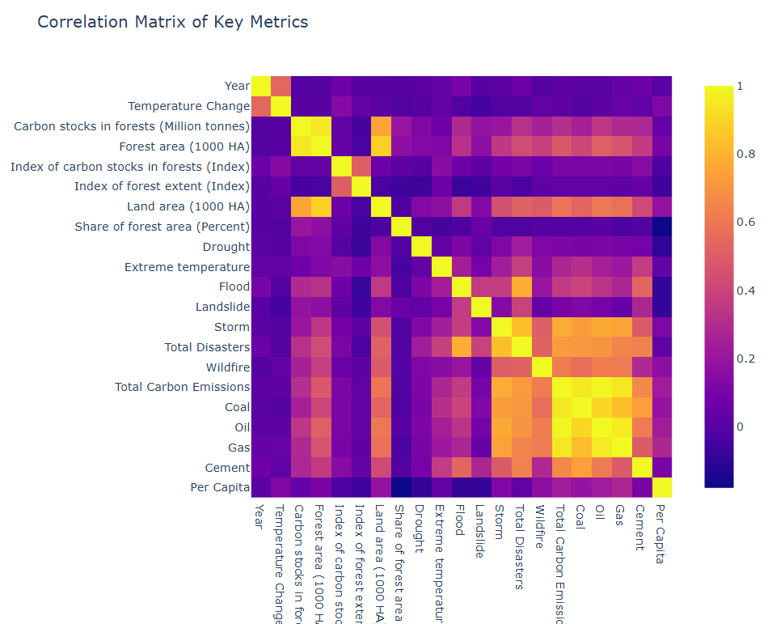
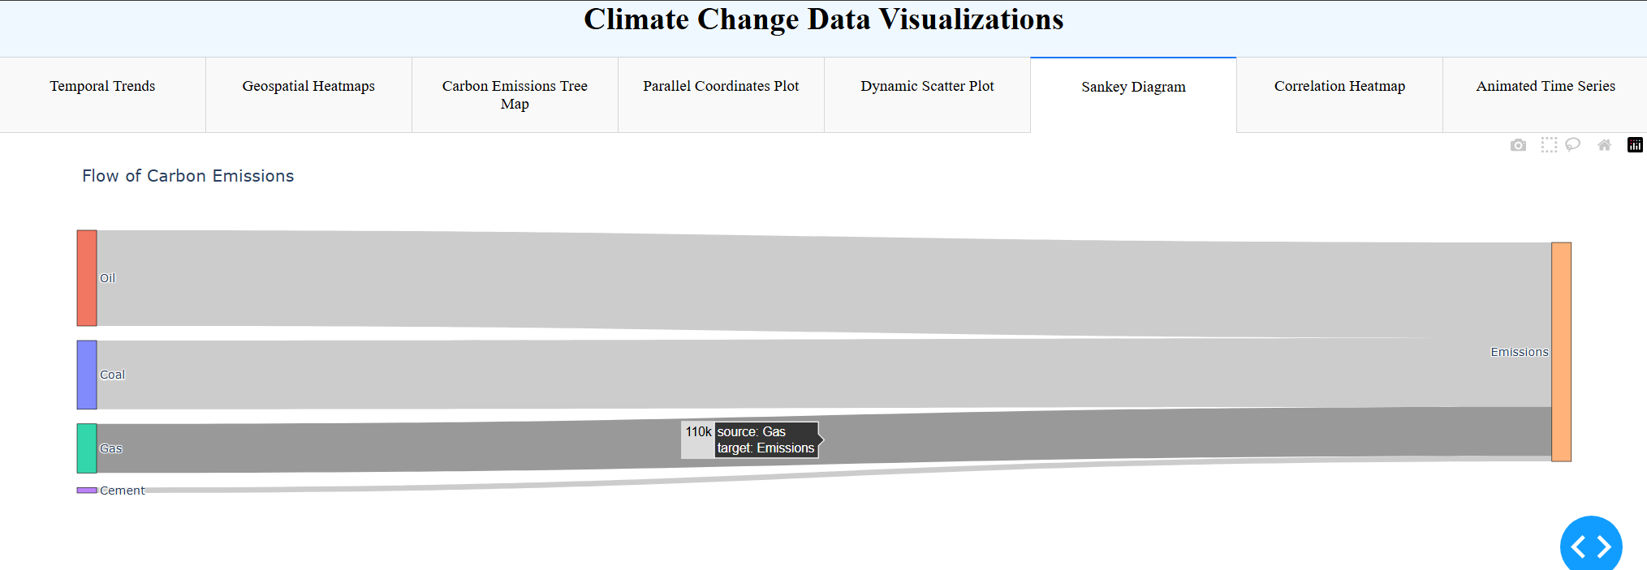
Correlation Matrix
Total Carbon Emissions by different sources

Slide 20
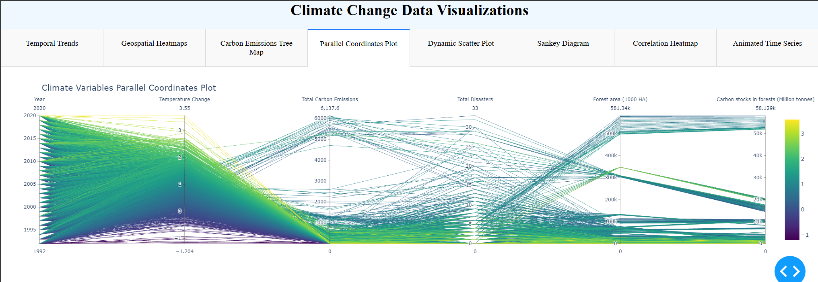
Analysis of Temperature, Carbon Emissions, Carbon Stocks, Disasters and Forest cover across the years

Slide 21
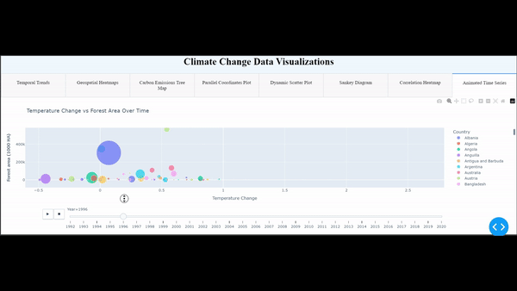
Temperature change vs Forest Area over time for all countries

Slide 22
Case Study
United States
The U.S. presents a unique and highly relevant case study for climate change due to its diverse geography, varied climate conditions, Policies, Public awareness, Data Availability and significant contributions to global greenhouse gas emissions.

Slide 23
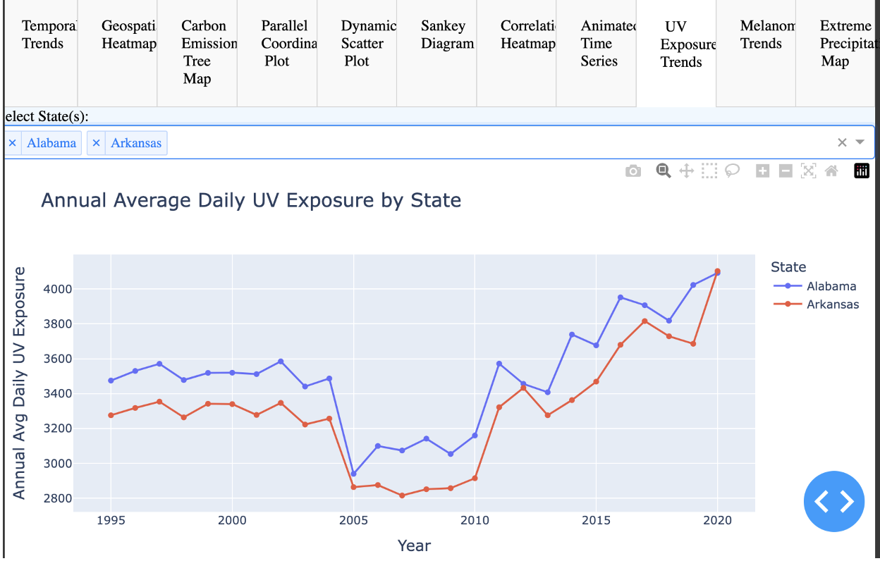
UV Exposure Analysis

Slide 24
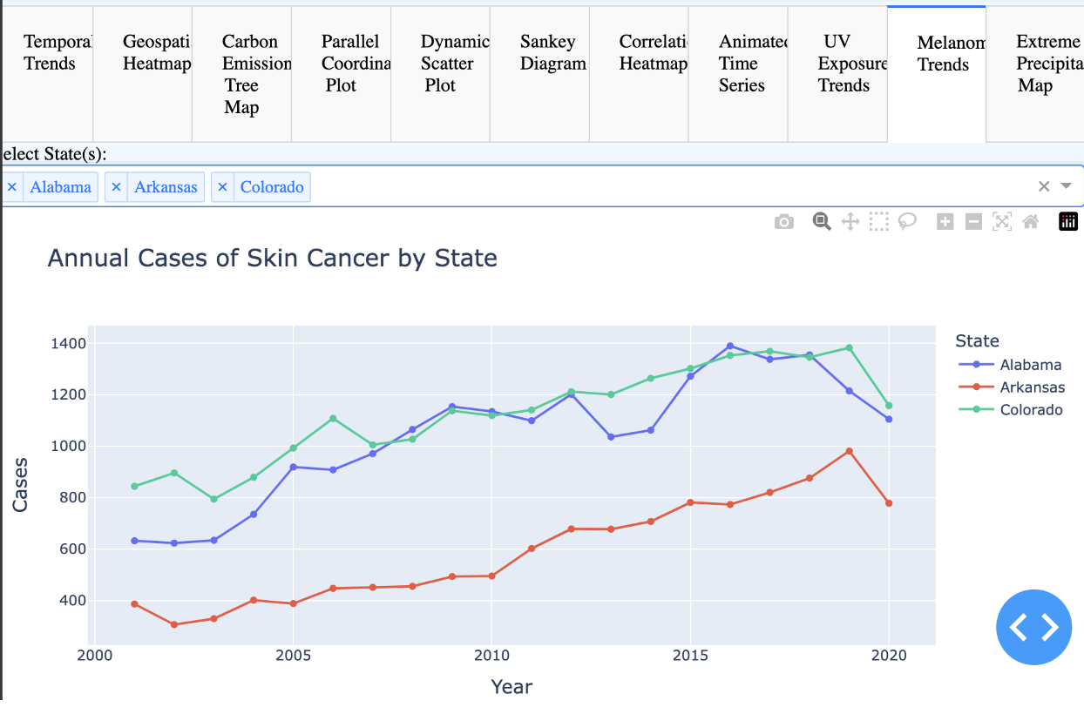
Skin Cancer Analysis

Slide 25
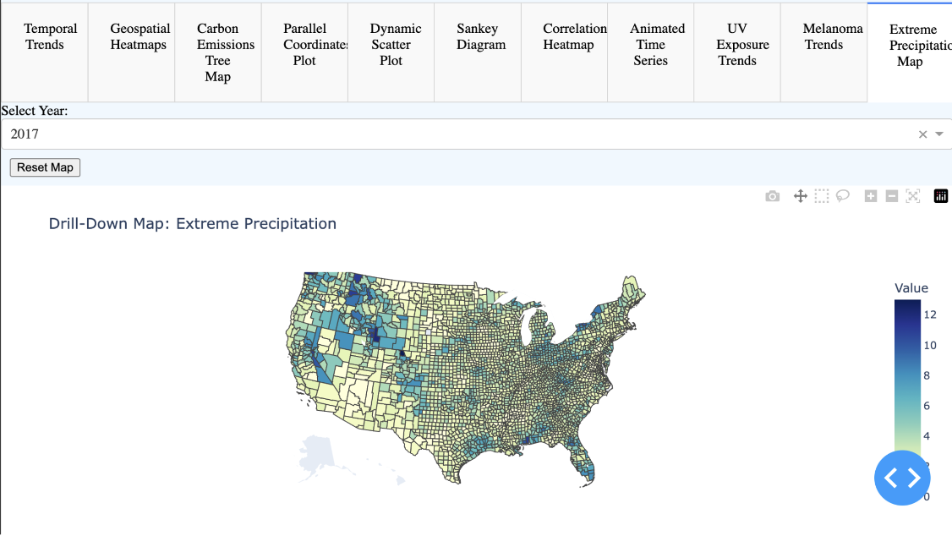
Extreme Precipitation - Choropleth Map

Slide 26
06
Conclusion

Slide 27
Takeaways
World Data:
As temperature change increases, frequency of disasters also increases.
As carbon emissions increase, the forest cover decreases.
More the forest cover, more is its capacity to have carbon stocks.
Forest cover decreases as Temperature Change decreases.
Different Types of Carbon Emissions are weakly but still correlated with disasters such as droughts, floods etc as they affect the climate in the long run.
The actual relationship between climate change, forest cover and natural disasters is way more complex than it seems.

Slide 28
Takeaways
US Data:
The choropleth map illustrates that counties experiencing extreme precipitation were primarily located on the west coast initially. Over time, however, the areas receiving extreme precipitation have shifted towards the eastern part of the USA.
Melanoma, a type of skin cancer, is caused by UV exposure. With the increase in UV exposure, primarily due to climate change, the number of skin cancer cases has also risen across various states.
We analyzed 20 years of UV exposure data across different states in the USA. The trend reveals a significant increase in UV exposure from 2000 to 2020.

Slide 29

THANK YOU

Slide 30

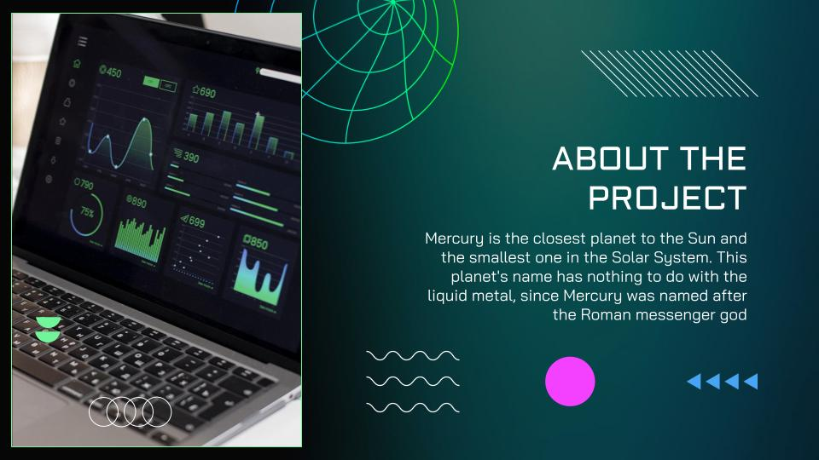

OUR VIDEO LINK
Link - https://youtu.be/4HLkfctFBoE

